Slide 1

Finance for IT managers
International Masters
Spring 2022 program
© Sylvie Appriou

Slide 2
Case Study New Corp IT budget

Slide 3
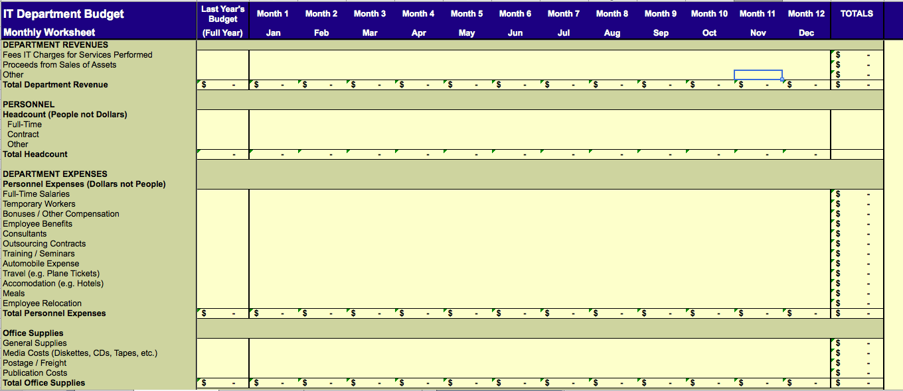
Budget model

Slide 4
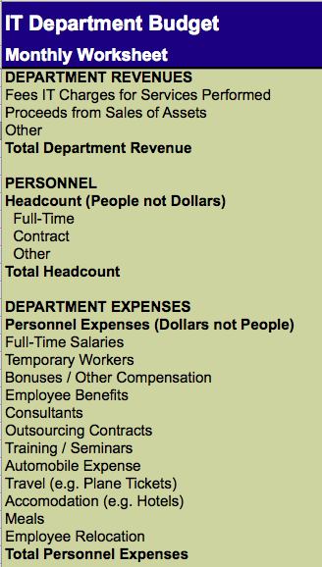
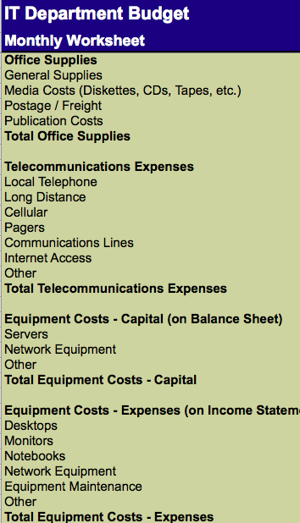
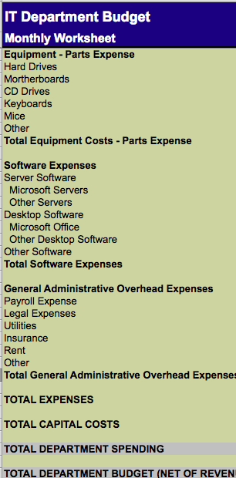
Budget model

Slide 5
Case study details (1/4)
Despite the global economic climate, New Corp. has managed to continue growing at a slow pace for the past three years.
The outlook for 2015 is more favorable as New Corp. was short-listed on several large sales opportunities, which could materialize in 2015.
Your CEO anticipates business to grow faster than recently and plans on a 20% annual sales growth for next year.
New Corp. plans on growing the sales team by 15% and the rest of the organization by 10%
IT is key to New Corp.’s strategy, hence why you were recently hired
The company runs on an ERP system, implemented last year, after two previous unsuccessful attempts.
Your servers run at 78% capacity and despite a few data availability issues this year, your team seems to meets all SLAs.
The Marketing manager asked to meet with you next week, as she wants to discuss the revamping of New Corp.’s web site with you.

Slide 6
Case study details (2/4)
In addition of supporting the growing business with your IT department, your CEO mentioned during your interview that:
He would like to invest into an HR system to automate all HR activities and provide an HR tool to all managers. Your CEO already knows from a friend of his (President of a large software company specialized in HR packages) that he could implement their HR system for less than 120,000USD, within 9 months, with the addition of contractors and consultants.
He is frustrated at sales representatives keeping all of their sales contacts and sales forecast data privately on their own laptops. The loss of key sales data hurt New Corp. severely last summer when the most senior and performing sales representative left the company.
He trusts you for making a full assessment of the IT situation and come up with recommendations on where you see priorities and opportunities to reduce costs and improve productivity.

Slide 7
Case study details (3/4)
You met individually with all of your permanent team members and gathered that one person on your team is keen on moving into project management, with additional training. Another person on your team has indicated she is interested into moving to HR as a future career move.
Bob, the sales manager you met at the first leadership meeting has been very vocal about the need to equip his entire sales representatives with iPads to have access to sales and technical information at all times, to be able to forecast when visiting customers. Your CEO doesn’t seem to have a clear position on the question but doesn’t seem able to say “no” to Bob.
You already started planning the requested implementation of the HR system into your budget with the addition of 1 full-time consultant from March and 5 contractors between June and November. You haven’t yet included any of the software license, equipment or non-personnel costs into your budget. You also expect to learn more from meeting with the HR manager soon. You are also considering some of the SaaS solutions available on the market, as a way to speed up implementation time frames and reduce CapEx expenditure.

Slide 8
Case study details (4/4)
You will end 2014 with a team of 8 people (Cell B14 on tab 2), yourself included.
Your CEO didn’t mention this directly to you but you are aware of the idea of an acquisition being discussed at board level. You don’t know much about the potential targets but heard that foreign companies were being considered.
Finally, in your previous job, you had participated in the very successful implementation of a corporate data warehouse and BI solution, which you believe contributed to a 10% growth in sales and 25% cost reduction.

Slide 9
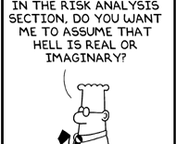
Tips for your case study
Remember to:
Automate (leverage Excel features)
Focus on material items
Be honest
Make time to do it right
Iterate
Review and improve

Slide 10
Recap on your budgeting process
Your budget should:
Be aligned with your organization’s vision, mission, goals and objectives
Fit your planned activities / services. Do not make your activities fit your budget
Look forward, show what you plan to do
Cover all the activities you want to undertake. If it is not in your plan, you will not have kept any money aside for it or arranged to find the money to pay for it
Plan for uncertainty and changes

Slide 11
Recap on your budgeting process
Focus on what is material, ie :
Revenue
Personal expenses
Prepare your overall “story” (2 slides)
…so that you can defend your budget : you are the advocate for the IT department !
Think of a few negotiation points if you are asked to decrease your budget

Slide 12
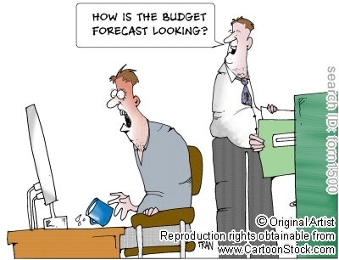
Let’s review your own budget proposals for New Corp.

Slide 13
Key elements for 2015 budget (1/2)
General
+20% annual sales growth, +15% Sales HC, +10% other HC
IT perceived as strategic value
Ongoing activities
End of 2014 : 8 people. HC + 10%
1 person wants to move to Project Management (training required)
1 person wants to move to HR
ERP system support
Servers at 78% of capacity. All SLAs met

Slide 14
Key elements for 2015 budget (2/2)
Potential projects
HR system : 120 k$, 9 months with addition of consultants / contractors
- 1 full time consultant from March, 5 contractors between June and November
No licence or other costs included yet…
Sales Forecast system : TBD
Re-vamping of NewCorp website : TBD
Full assessment of IT with recommendation of priorities / opportunites to reduce costs and improve productivity
iPads for sales representatives : TBD
Acquisition ?
Data warehouse and BI system ?

Slide 15
Assumptions and budget (1/6)
Revenue
IT fees (150 $ / month and employee) assumed to grow by 10% by the end of the year
Assume no revenue from sales of assets

Slide 16
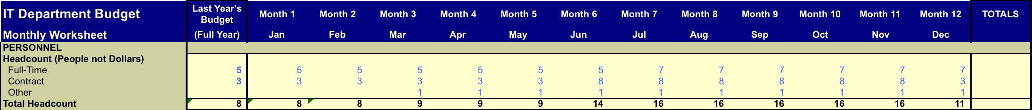
Assumptions and budget (2/6)
Personal
Assumes 2 additional full time HC starting in July to support company growth and projects : to be negotiated….Argument :
IT needs to be able to support company growth
IT viewed as strategic
Needs to be in a position to support the HR project when done
Many potential projects on the table…
5 contractors from June to Nov for HR project
1 consultant from March to Dec for HR project
May want to discuss Employee vs Contractors as pontential savings could be realized…

Slide 17
Assumptions and budget (3/6)
Personal
Full time employee : 65 k$ / year and per person (same as previous year)
Bonus / Other comp : 700 $ / month and person (same as previous year)
Employee benefits need to discuss with HR
Consultant : assumes 100k$ / year and per person
Contractor : assumes 85k$ / year and per person
Training seminar : assumes 2 days / month and per person, ie 600 $ per person
Assumes no automobile expense
Assumes 200$ / month and per person for all T&E
Employee relocation : check with HR

Slide 18
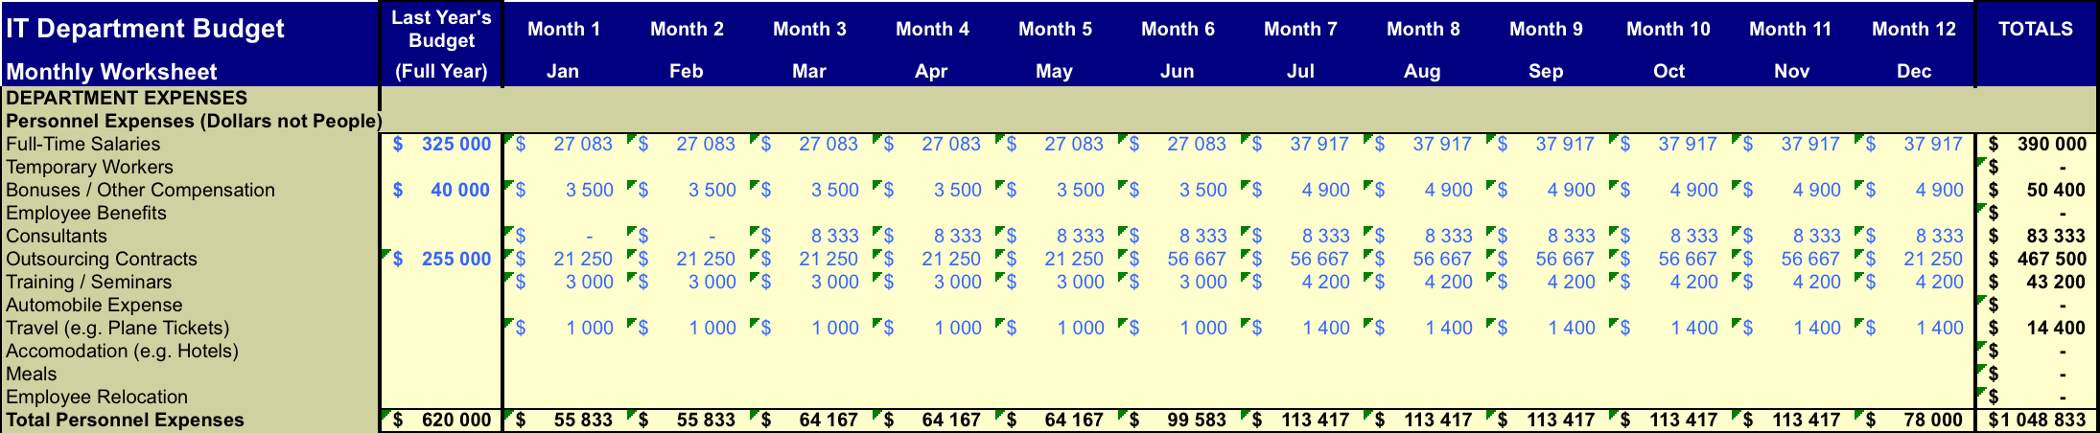
Assumptions and budget (4/6)
Personal

Slide 19
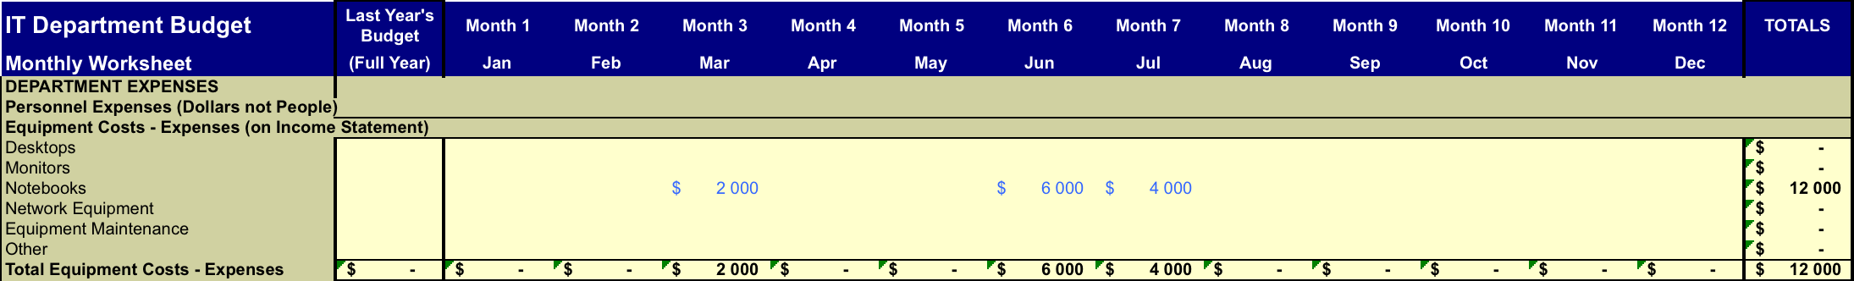
Assumptions and budget (5/6)
Other
Office supply : check with HR : it is probably a nb / HC (needs to include all HC, employees and contractors)
Same thing for Telecoms expenses : could assume 150$ per month and person in total (include all HC)
Equipment costs Balance Sheet : need to review if any new expense and how these should be managed : in IT budget or in overall Fixed Assets budget ?
Equipment costs Income statement : include desktop equipment for newcomers for employees and contractors (assumes 2,000$ / pers)

Slide 20
Assumptions and budget (6/6)
Other (Con’t)
Part expenses : to be reviewed with Finance : number per person ?
SW expense :
assume site licence already amortized or outside IT budget…
Need to discuss if and when to include HR SW licence (60,000$)
Overhead
Payroll expense : assumes 50 $ / month and per person
Other to be discussed with Finance

Slide 21
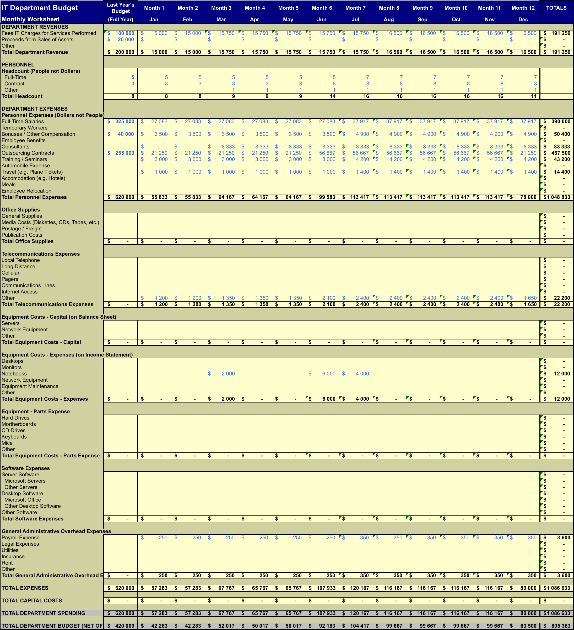
Budget summary

Slide 22
Budget summary (1/2)
Budget increase is 113% compared to last year or 475 k$ (420 k$ vs 895 k$), driven by :
- 20 k$ revenue
Out of 475 k$ delta, 428 is HC related
HR project : + 296 k$ (without SW licence)
Consultant for 10 month = 83 k$
5 contractors for 6 months = 213 k$
2 extra HC from July on… : + 65 k$ + misc (training, equipment…)
Does not include :
iPads for Sales force
Development of Sales Forecast system (wait for the outcome of the IT priorities assessment)
Any acquisition of significant size
Data warehouse and BI project…

Slide 23
Budget summary (2/2)
Flexibility :
1 full time employee (impact 33 k$) : may not be able to do the web re-design project then….
Postpone HR project (impact 43 k$ : month)
Do not do HR project : impact 300 k$
Replace 3 Contractors by FTE (impact 60 k$)

Slide 24
Thank you!
See you next time

